Slide 1
Eagle CAD Workshop (0)
Preliminary Meeting

Slide 2
Things to Cover
Setting up GitHub
Connecting Workshop Materials
Setting up Eagle CAD
Setting up folders and files
Modifying settings

Slide 3
GitHub?
Version control system for tracking version changes throughout different people.
Mainly used by programmers for source code management
Can be used for any files however
Design files for CAD
Text files
Etc.

Slide 4
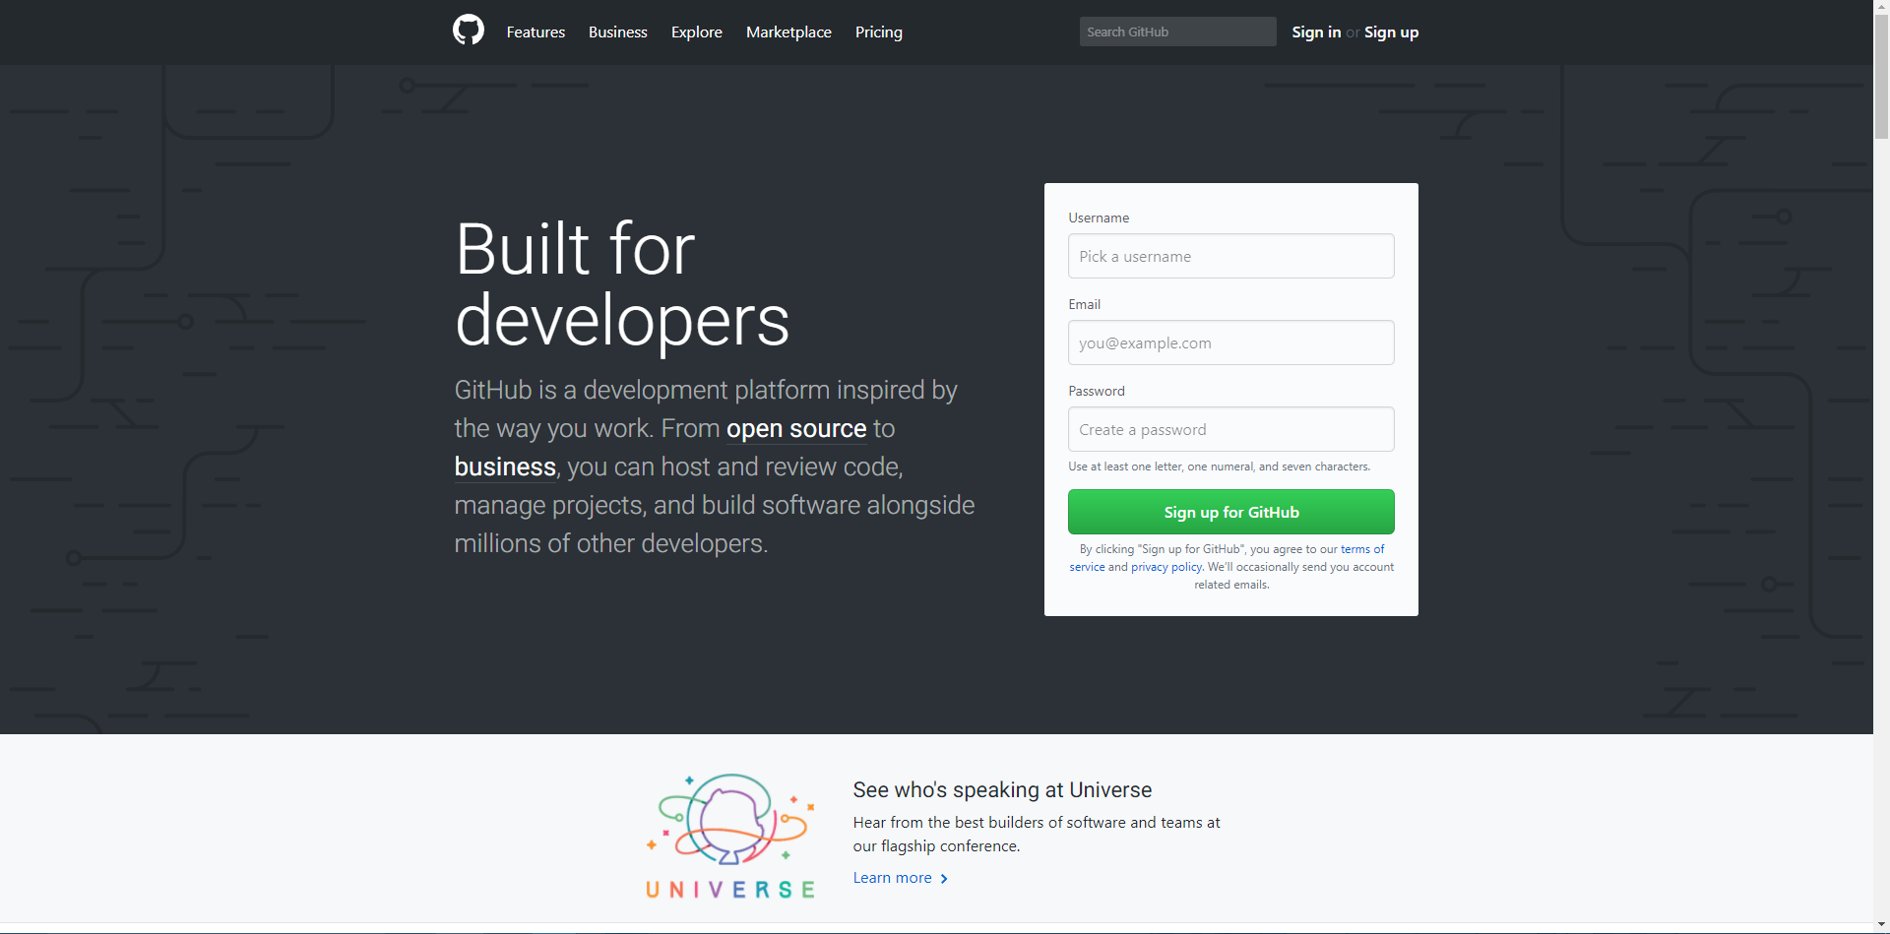
Create Account

Slide 5

Download GitHub Desktop
https://desktop.github.com/
Be sure to download Stable version located at the bottom!
Once download is complete, install, and launch the application.
You will be asked to login at first-time launch.

Slide 6
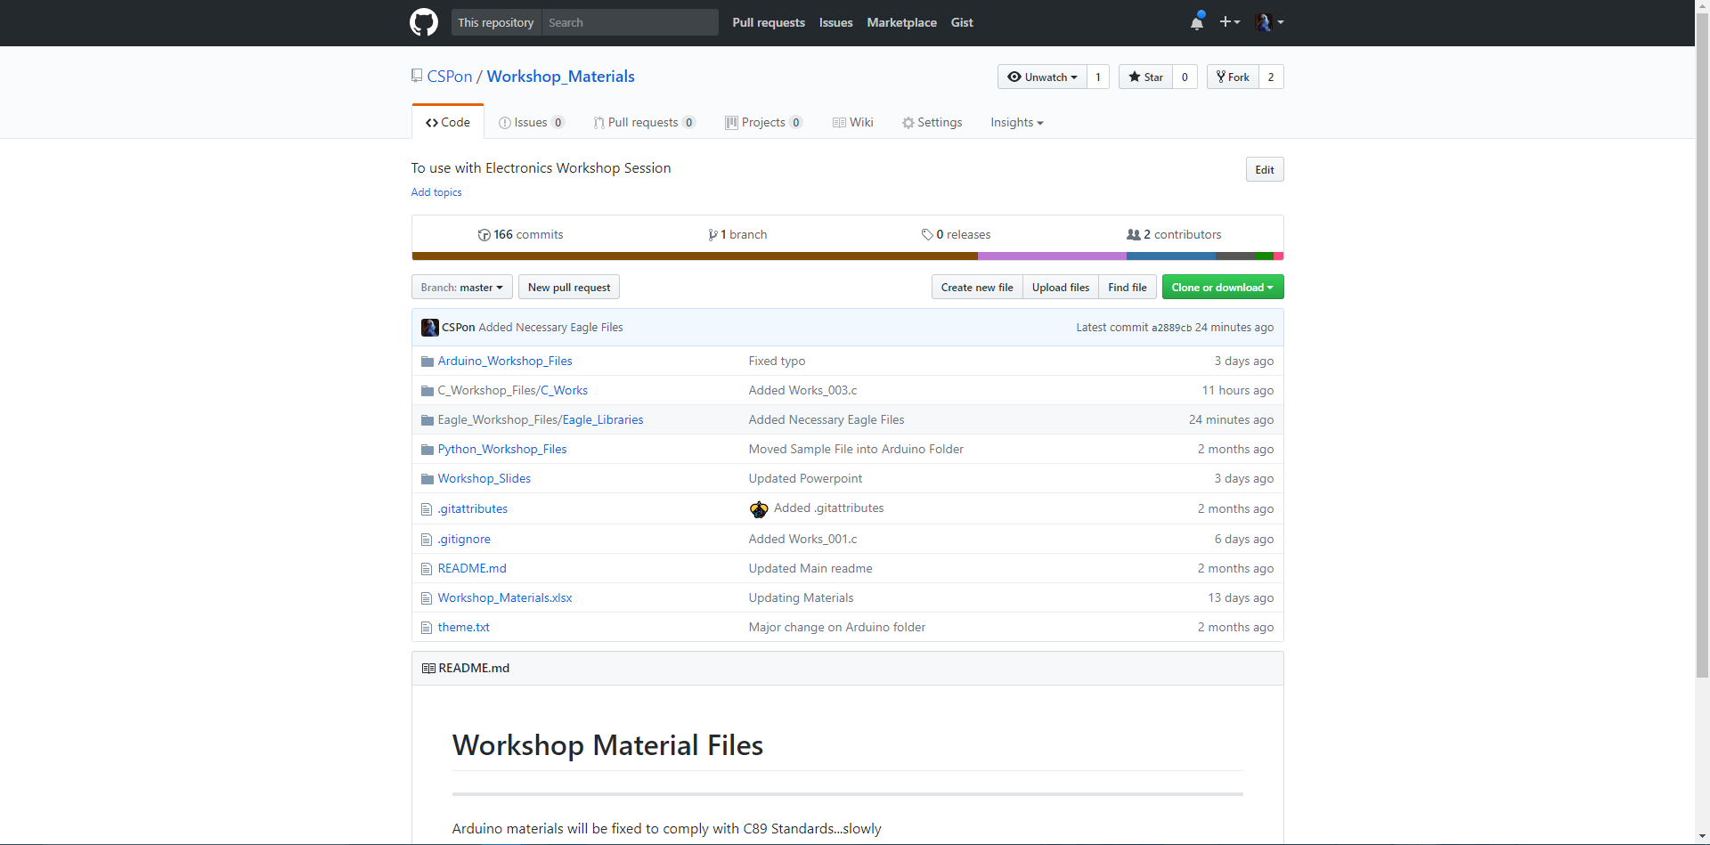
Forking the Original Repository
Press the button,
NOT the number!
https://github.com/CSPon/Workshop_Materials

Slide 7
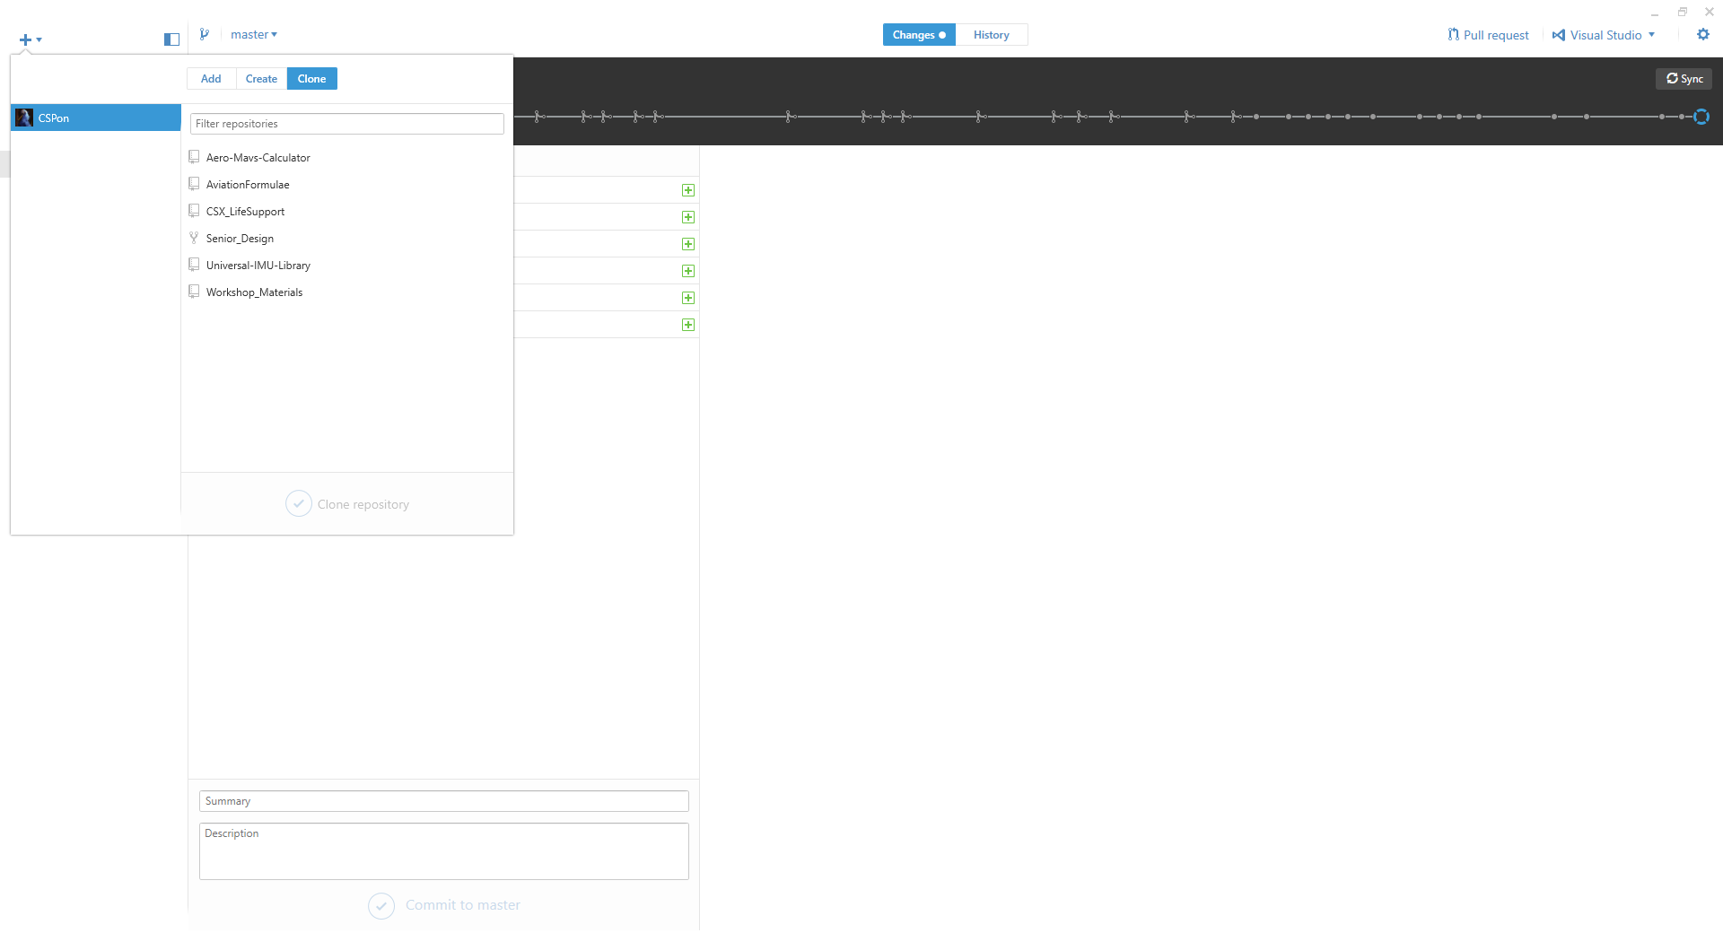
Clone Forked Repo to Computer
Click the + sign
Any repo forked from other repo will have little ‘Y’ symbol
Click to clone repo to your desktop!

Slide 8
To Update Repository…
Whenever new material is added to my original repository, you must update your forked repository to apply changes.
To do so, simply click on ‘sync’ button, then click on ‘Update from …/master’

Slide 9
To Update Repository…(Cont.)
If however, repository fails to update, you may ‘force’ update by using shell command.
Right click on forked repository, then click ‘Open in Git Shell’
Once the shell opens, type git pull https://github.com/CSPon/Workshop_Materials.git
Be sure to have YOUR repository opened before sending the command!

Slide 10
To Update Repository…(Cont.)

Slide 11
Eagle CAD Installation
Provided by AutoDesk
Up to 2 schematic sheets, 2 signal layers, and up to 80cm^2
https://www.autodesk.com/products/eagle/free-download
Download, then install
You MUST have Autodesk account to use the software!

Slide 12
Setting up the Software
Once Control Panel for Eagle CAD opens, click Options > Directories…
For Libraries, add a semicolon and add path to your library directory
For example; $EAGLEDIR\lbr; D:\EAGLE FILES\LIBRARIES
For Projects, delete original directory and add path to your own project directory
For example; D:\EAGLE FILES\PROJECTS

Slide 13
Backup/Locking
In Control Panel, Click on Options > Backup / Locking…
We do not want any backup or locking for files. This will cause mess in our project folder.
Set Maximum Backup level to zero (0)
Set Auto Save interval to ‘off’
Uncheck ‘Enable File Locking’
You can leave ‘Automatically save project file’ checked.

Slide 14
Setting up the Software
In Control Panel, press F5 to refresh the libraries and project directories.
Right click on Projects, click on New Project
Name the new project as Workshop_Projects
Right click on Workshop_Projects, then click New > Schematic
Now we will modify some file specific settings.

Slide 15
Key Assignment
Within schematics window, click on Options > Assign…
Delete Alt+F2 function.
Double click on F2 function and change command to ‘add’
Change other functions as follows;
F2 -> add
F3 -> group
F4 -> move
F5 -> net
F6 -> name
F7 -> value
F8 -> delete
F9 -> grid

Slide 16
Key Assignment (Cont.)
Within schematics window, click on Options > Set…
Click on Misc tab
Uncheck
Auto set route width and drill
Group command default on
Click OK to save settings
Close the schematics window

Slide 17
Key Assignment (Cont.)
In Control Panel, right click on Workshop_Projects, then click New > Board
Now we will modify some file specific settings.
Within board window, click on Options > Assign…
Change the function assignments as follows;

Slide 18
Key Assignment (Cont.)
F2 -> rats
F3 -> group
F4 -> move
F5 -> route
F6 -> name
F7 -> value
F8 -> rip
F9 -> grid
Click OK to save the settings
You may close the board design window

Slide 19
Modify Font Setting
Within layout window, click Options > User Interface…
Check on following settings
Always vector font
Persistent in this drawing
You may change the layout and schematic background color and cursor size if you wish. (I use black background with large cursor)

